Slide 1
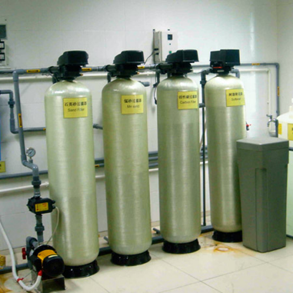
Water supply for haemodialysis
  principles of operation
    function
    use
    scientific principles
  construction
    components
    system diagram
    inputs/outputs
  troubleshooting
    identifying common faults
    replacing components
    rectifying faults
  safety considerations
    user and patient safety
    electrical safety
  performance monitoring
    quality assurance and control
18.5.3 Maintain a water supply for haemodialysis
Unit C18.5 Maintaining Haemodialysis Equipment
Module 279 19 C Medical Instrumentation II
©
dr. Chris R. Mol, BME, NORTEC, 2015

Slide 2

Introduction
Haemodialysis machines are artificial kidneys that perform most, but not all, kidney functions for patients who have permanent or temporary renal failure.
The patient's blood is circulated through the machine where it is filtered and balanced for electrolytes, pH, and fluid concentration before being returned to the patient.
Haemodialysis machines use a lot of water, up to 150 litres of dialysis fluid per treatment session. This is brought in close contact with the patient’s blood, only separated from it by a semi-permeable membrane. Any impurities in the water may end up in the blood and the body of the patient.
To avoid this, it is critically important that the water used during haemodialysis is adequately clean and free of impurities.
Since this water must be more clean than normal drinking water, a special water purification system must be installed and maintained for haemodialysis.
©
Water supply for haemodialysis
dr. Chris R. Mol, BME, NORTEC, 2015

Slide 3
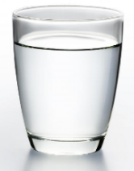
Water Quality
The recommendations of the World Health Organisation (WHO 1992) relating to potable water aim to provide water that is physically, bacteriologically and chemically safe to drink. To achieve these standards, the incoming water undergoes several stages of treatment.
This treatment often involves:
  the addition of chemicals to facilitate the removal of suspended compounds and other constituents.
  the addition of disinfection agents to control bacteriological contaminants.
Therefore, drinking water is not clean enough for haemodialysis !
The medical literature contains many reports of patient injury or death associated with inadequately treated or monitored water supplies used in dialysis. Adverse patient reactions caused by chemicals or their residuals that may contaminate water used for dialysis exhibit a wide range of symptoms including headache, hypotension, or even death.
Ideally pure water used for dialysis should contain no contaminants e.g. particles, trace elements, chemicals, organic matter, or bacteria. Published accepted standards of water quality do exist (e.g. AAMI, 2001; 2004) and specify the minimum concentrations of contaminants that are allowed, bearing in mind that absolute purity is impossible.
©
Water supply for haemodialysis
dr. Chris R. Mol, BME, NORTEC, 2015

Slide 4
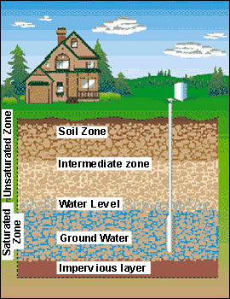

Water source: incoming supply
The typical water treatment system for dialysis will depend upon the quality of the incoming supply. Different contaminants require different treatment processes for their removal. The lower the concentrations of contaminants the less elaborate the purification system.
For instance, the size, number and types of filters necessary for a water purification installation with good quality piped water would be different from those with borehole water. Differences can be due to geology in the area of the source water (e.g. high iron or clay content), and local industry or farming practice (e.g. pesticide use or heavy metal contamination) in the area.
Municipal water is primarily sourced from 2 areas,
  surface water &
  groundwater.
Groundwater has less organic materials but higher inorganic ions e.g. metals. Surface water has more organic matter, microbes and contaminants (e.g. pesticide, sewerage).
©
Water supply for haemodialysis
dr. Chris R. Mol, BME, NORTEC, 2015

Slide 5
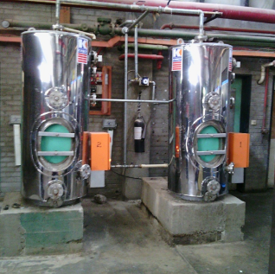
Water source: incoming supply
Haemodialysis services in hospitals frequently derive their water supply from the hospital water distribution network. Such networks are complex, can contain regions of low flow or stagnation, and frequently incorporate a storage tank to ensure adequate water pressure and availability of supply in times of peak demand. Like any water distribution network, those in the hospital are subject to bio-film formation.
hot water system at Ndola Central Hospital
©
Water supply for haemodialysis
dr. Chris R. Mol, BME, NORTEC, 2015

Slide 6
Water purification steps for normal drinking water
There are several processes involved in converting source water to drinking water standard.
These include:
  Sedimentation by which large particles are allowed to settle;
  Flocculation where particles that remain suspended are removed by adding a coagulant (e.g. aluminium or iron sulphates) to form larger complexes called flocs, which are then removed, through a process of filtration;
  Softening where calcium and magnesium salts are removed;
  Oxidation and disinfection is most commonly achieved with the addition of chlorine;
  Carbon filtration the water is finally passed through a carbon filter to remove any remaining chemicals.
©
Water supply for haemodialysis
dr. Chris R. Mol, BME, NORTEC, 2015

Slide 7
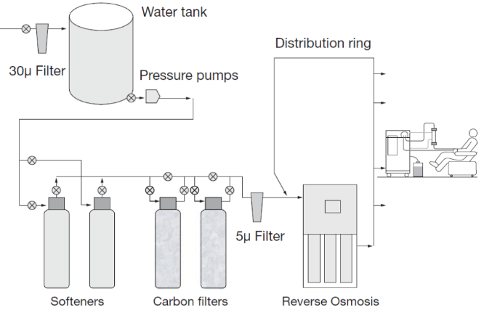
The dialysis water treatment system
Purified water for dialysis must meet the requirements for ionic and organic chemical purity and must be protected from microbial proliferation.
It is usually prepared using drinking water as feed water and is purified using operations that may include ion-exchange, Reverse Osmosis, filtration, or other suitable procedures. This will be explained further on.
A feed water tank is quite often used to provide a buffer from the supply and allow pressure booster pumps to be used to give a constant supply.
Simple direct feed water treatment system
©
Water supply for haemodialysis
dr. Chris R. Mol, BME, NORTEC, 2015

Slide 8
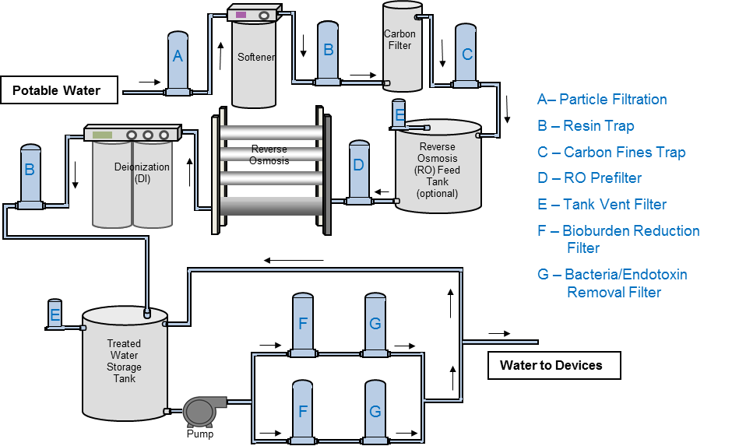
(typical)
System overview
©
Water supply for haemodialysis
dr. Chris R. Mol, BME, NORTEC, 2015

Slide 9
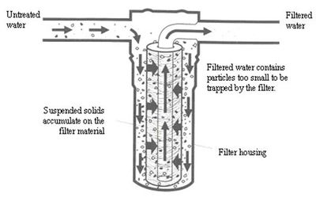
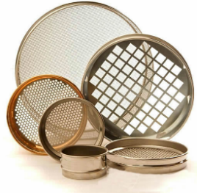
Particle filtration (micron filters)
Water contains particulate matter, which may include sand, clay, silt, etc.. Particle filtration is used primarily to protect the equipment further on in the chain (RO membranes!) from becoming clogged with dirt.
Filtration is generally achieved by using what is basically an ultra-fine sieve capable of removing fluid borne particles which are larger than the pore size of the filter membrane.
©
Water supply for haemodialysis
dr. Chris R. Mol, BME, NORTEC, 2015

Slide 10
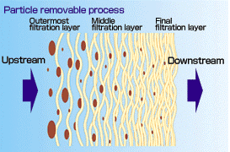
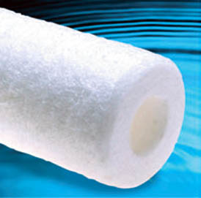
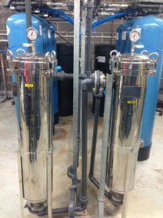
Particle filtration (micron filters)
There are two general types of filter which are routinely used:
Depth filters
  With depth filters particles are trapped throughout the media. The most important factor in determining effectiveness of depth filters is the porosity throughout the media.
Depth filters have a graded density, i.e. lower on the outside and increasingly higher toward the inside. These have a higher dirt holding capacity than single density filters. The effect is to trap larger particles toward the outside and finer particles toward the inside. This type of filter is usually employed as coarse filters (typical rating 5 - 30 micron) in the incoming water stream to remove larger particulate matter.
©
Water supply for haemodialysis
dr. Chris R. Mol, BME, NORTEC, 2015

Slide 11
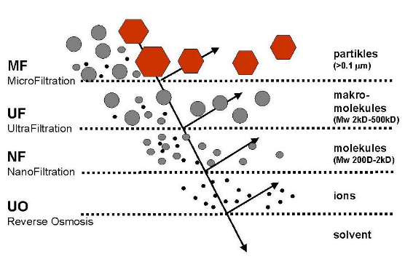
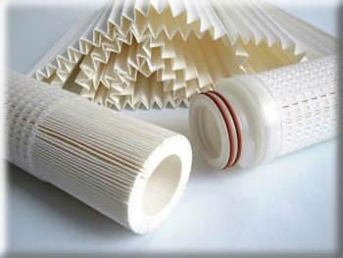
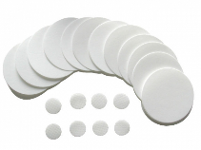
Particle filtration (micron filters)
2. Membrane filters
  With membrane filters particles are trapped at the surface of the media, as in a sieve. They have a defined pore size. Membrane particle filters typically use a flat sheet media, membrane or specially treated non-woven material to trap the particles. The media is usually pleated to provide a larger surface area.
These filters are usually positioned
after all the pre-treatment components and
immediately before the RO pump and membranes.
©
Water supply for haemodialysis
dr. Chris R. Mol, BME, NORTEC, 2015

Slide 12
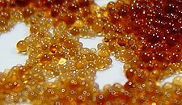
Ion exchange: softening of water
Ion exchange is the reversible interchange of ions between a solution and an ion exchanging material. In water treatment, the principle of ion exchange is used to remove unwanted ionic impurities. This is achieved by passing hard water containing calcium and magnesium ions through a vessel containing an exchange resin in the form of small, porous beads. The calcium and magnesium ions are exchanged for sodium ions; it is the sodium ions which give the water its ‘softness’.
The resin is ion specific so only calcium and magnesium ions are removed and replaced by sodium. Once all of the sodium ions have been exchanged, the softening process ceases. The resin then needs to be regenerated by flushing with a strong brine solution containing large amounts of sodium chloride, enabling the reverse exchange to occur. The calcium and magnesium are disposed of by flushing to drain.
exchange resin
Most dialysis facilities use a permanent softener that incorporates a brine tank and control head that automatically executes the regeneration cycle.
©
Water supply for haemodialysis
dr. Chris R. Mol, BME, NORTEC, 2015

Slide 13
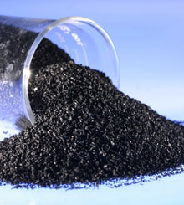
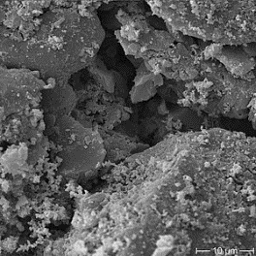
Carbon filtration
The main purpose of using activated carbon is to remove chlorine from the water. The term ‘activated’ refers to the process by which the carbon is processed in order to enlarge its pore structure to increase its adsorptive power.
Activated carbon removes chlorine by attracting and holding the chlorine onto the carbon granules. The ability of activated carbon to remove contaminants is determined not by its weight or volume, but its adsorption capacity.
Adsorption is a process where a solid is used for removing a soluble substance from the water, where the substance is attached to a surface. The adsorptive capacity depends on the contact time of the water to the carbon, therefore the more water required, the bigger the carbon tank.
Granular activated carbon (GAC) is commonly used in dialysis water treatment systems.
carbon granules
GAC electron microscope image
©
Water supply for haemodialysis
dr. Chris R. Mol, BME, NORTEC, 2015

Slide 14
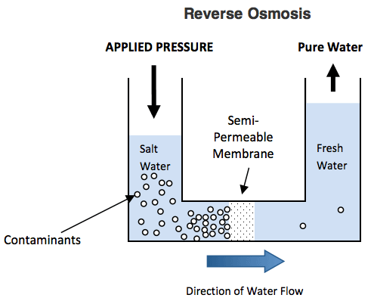
Reverse osmosis (RO) unit
Reverse Osmosis will generally remove any molecular compounds (incl. minerals, ions) smaller in size than water molecules. Such compounds include salt, manganese, iron, fluoride, lead, and calcium (chemical contaminant removal).
Reverse osmosis works by using pressure to force a solution through a membrane, retaining the solute on one side and allowing the pure solvent (e.g. water) to pass to the other side.
Feed water under pressure is pumped into a module containing a semi-permeable membrane. Provided the applied pressure exceeds the natural osmotic pressure of the impure water, a proportion of the feed will pass through the membrane, which rejects most of the contaminants. This forms the “permeate.” The contaminants accumulate in the residual “concentrate” stream which is discharged to drain.
Thin-film composite RO membranes can remove up to 99.5% of the inorganic ions from the feed water, together with virtually all micro-organisms, pyrogens, and other organic macromolecules. Thus, water purified by RO will be essentially free from endotoxins and from inorganic toxins, such as aluminium.
©
Water supply for haemodialysis
dr. Chris R. Mol, BME, NORTEC, 2015

Slide 15
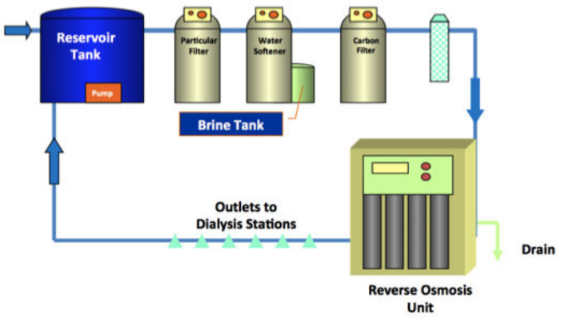
Distribution pipe work
The 2009 ISO guidelines recommend that piping should not contribute any chemicals e.g. copper, lead, zinc or chemicals. Common practice is the use of PVC (polyvinyl chloride) piping as it is non corrodible, is able to withstand high temperatures achieved during disinfection and has a smooth inner surface to prevent biofilm.
The distribution pipework is usually constructed in a loop, allowing surplus water to be returned to the input side of the RO.
As water treatment systems are susceptible to microbial contaminations, periodical disinfection is mandatory to obtain levels expected by international water quality standards.
©
Water supply for haemodialysis
dr. Chris R. Mol, BME, NORTEC, 2015

Slide 16



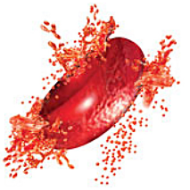
Water temperature regulators
As blood is passed through a dialysis circuit, heat is radiated to the cooler ambient temperature and then is brought into contact with dialysis water.
In most units the temperature of dialysis water is typically regulated at 35 ºC.
Dialysis machines are capable of heating - but not cooling - dialysis water to the required temperature. Therefore, the feed water needs to be between 10 ºC and 30 ºC. If feed water is outside this range, it needs to be adjusted before entering the dialysis machine.
Feed water temperature also affects the integrity of the RO and particle filters, which have a maximum operating temperature set by the manufacturer, usually not more than 35 ºC.
A high dialysate temperature can result in haemolysis, destroying the blood.
Normal
Haemolysis
©
Water supply for haemodialysis
dr. Chris R. Mol, BME, NORTEC, 2015

Slide 17
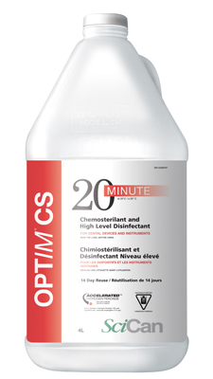

Maintenance
Disinfection:
Heat disinfection can be done by heat fluid to 85 ºC for 15 minutes. This can eliminate waterborne bacteria. But it will not kill spore-forming bacteria. Chemical disinfection (e.g. using formaldehyde) can be used instead.
Disinfection treatment using heat or chemicals is usually done daily on every machine and after each patient’s treatment.
In addition to daily disinfection, sodium hypochlorite (bleach) is used to disinfect the machine weekly. It is important to rinse the machine thoroughly after chemical or bleach disinfection to remove all chemical residuals before the machine is used on patients.
Exchange/regeneration of filters etc. according to manufacturer specification.
This type of system is much too complex to discuss maintenance in a few hours. Courses of many months are given to technologists who are trained to do maintenance, often before a dialysis machine is installed in a hospital.
Without a trained expert, the machine cannot be used…..
©
Water supply for haemodialysis
dr. Chris R. Mol, BME, NORTEC, 2015

Slide 18
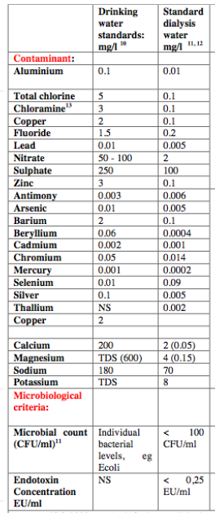
Water quality testing
ISO recommendations for water quality in dialysis water
The ISO recommends at least annual testing for chemical contaminants and quarterly testing for microbiological contaminants.
Perturbations in feed water quality and breakthrough in upstream filters do not usually result in fouling of the dialysis water, as there is a fair degree of redundancy (over-capacity) built into each filter.
Simplified product water quality can be measured by either conductivity in micro-Siemens/cm (μS/cm) or total dissolved solids (TDS) displayed as mg/L or parts per million (PPM).
Water samples are best sent to an experienced testing facility for analyses.
©
Water supply for haemodialysis
dr. Chris R. Mol, BME, NORTEC, 2015

Slide 19

END
The creation of this presentation was supported by a grant from THET:
see https://www.thet.org/

